Slide 1
EQUILIBRIUM OF THE FIRM AND INDUSTRY UNDER PERFECT COMPETITION
Perfect competition,
The following conditions are found in the market :
1.There are a large number of firms producing and selling a product.
2.The product of all firms is homogeneous.
3.Both the sellers and buyers have perfect information about the prevailing price in the market.
4.Entry into and exit from the industry is free for the firms.

Slide 2
Characteristic of Perfect completion
Large Number of Firms
A firm under perfect competition is price-taker and output-adjuster.
Homogeneous Products
It means that the products of various firms are indistinguishable from each other; they are perfect substitutes for one another.
Perfect Information about the Prevailing Price
Both the buyers and sellers are fully aware of the ruling price in the market.
Free Entry and Exit
Firm have complete freedom for the entry of new firms or the exit of the existing firms from the industry in the long run

Slide 3
The Demand Curve of a Product Facing a Perfectly Competitive Firm
Y
Perfectly elastic demand curve signifies that the firm does not exercise any control over the price of the product but can sell any amount of the product as it likes at the ruling price
Industry
Y
Firm
D
D
S
D
E
P
P P
AR = MR
E
AR = MR
AR = MR
E
D
S
D
D

Slide 4

PROFIT MAXIMIZATION BY A COMPETITIVE FIRM : TR-TC APPROACH
Y
F
At output level QM, the firm maximizes economic profits
Break-even point
TC
TR
K
H
Break-even Point
N
B
O
QB
QM
Qu Output X
Profit curve
h
b
QB
QM Qu Output
X
TOTAL REVENUE AND COST
PC

Slide 5
EQUILIBRIUM OF THE FIRM UNDER PERFECT COMPETITION
Short-run Equilibrium of the Firm
under perfect competition, the firm will equalize marginal cost with price to attain equilibrium output.
Revenue and Cost

Slide 6


1.MC = MR = Price 2.MC curve must be rising at the point of equilibrium.
Y
Y
a) Profit b) Loss

Slide 7
Deciding to Shut Down
When a firm stops production, that is, shuts down in the short run, it will have to bear losses equal to the fixed costs.
To make our analysis simple, we examine the question in two parts.
1. Situation when a firm decides to continue operating in the short run even when incurring losses.
2. Situation when a firm decides to shut down in the short run

Slide 8
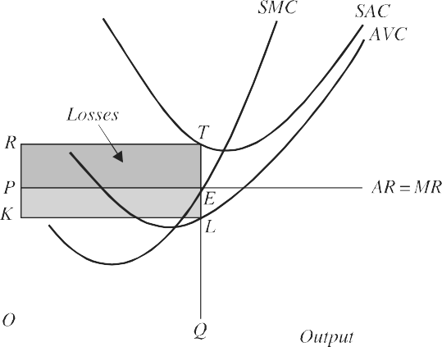
Situation 1
The firm will continue operating in the short run at a loss when total revenue exceeds total variable costs. This enables the firm to earn revenue to recover a part of the fixed costs.
TR > TVC
Since TR = P.Q, and TVC = AVC.Q
Therefore, P.Q > AVC.Q = P > AVC

Slide 9
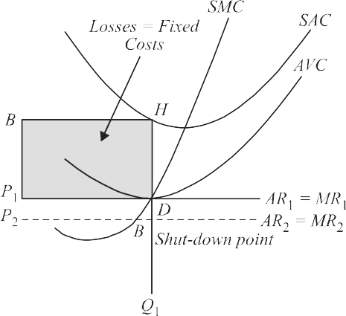
Situation 2 when a firm decides to shut down in the short run Situation 3 when firm actually shut down and does not operate
When Price (P) = minimum AVC, losses are equal to total fixed costs.
If price falls below it, the firm will shut down

Slide 10
Gresham's Law
Gresham's Law is an economic principle stating that
"bad money drives out good."
This means that if two forms of money are in circulation and one is perceived as having more intrinsic value (like a higher metal content), people will tend to keep the more valuable currency and spend the less valuable one. As a result, the "bad" money (the one of lower value) circulates more freely while the "good" money is hoarded or removed from circulation.
The principle can also apply more broadly to situations where lower-quality items or practices displace higher-quality ones in various markets or contexts. Would you like to know more about its implications or historical examples?

Slide 11
Market for lemons
The "market for lemons" is a concept introduced by economist George Akerlof in his 1970 paper. It describes a situation in markets where the quality of goods is uncertain, leading to adverse selection.
In this context, "lemons" refer to low-quality used cars, while "peaches" represent high-quality ones. Because buyers cannot accurately assess the quality of the cars before purchasing, they are only willing to pay an average price that reflects the expected quality. As a result, sellers of high-quality cars may withdraw from the market, leaving only low-quality cars (lemons). This can lead to a market failure, where good quality products are driven out by inferior ones.
The concept highlights the importance of information asymmetry—where one party has more or better information than the other—and its potential to disrupt markets. Would you like to explore its applications in modern markets or other examples

